Slide 1
Epidemic study based on community detection
Rares Cristian Neagu - 001136056

Slide 2
Can epidemic studies be improved?
Epidemic episodes are a reality
Determining how would a virus spread in a community is not easy
Determining how communities are affected is even harder
Finding communities and analysing their dynamics might lead to new conclusions
Preventive measures are more effective and less expensive
Less community disruption

Slide 3
Community Detection – How to do it
Humans form and part of multiple communities, but not all are relevant
Finding what communities to explore and how this communities are formed is important
We are interested in communities that facilitate the exposure to the virus (geographical location, social networks, etc)
Modularity is the perfect metric for this application

Slide 4
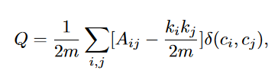
Louvain algorithm – Modularity
Modularity measures how connected is a community compared with the rest of the network.
The more interconnected a group of nodes is the more likely it is to be a community
Beneficial in studying a viral spread
Louvain algorithm maximises modularity, separating the graph into more and more well connected subgraphs.

Slide 5
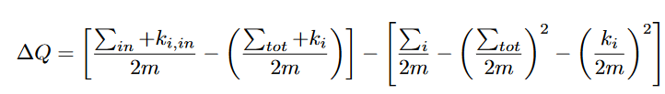
Louvain Algorithm
One of the most used algorithm in community detection
Countless applications and variations
Step 1: Assign node to a different community until the maximum value of modularity is found
Step 2: merge found communities.
Step 3: Repeat until no more improvements are recorded

Slide 6
The SEIR Model
Susceptible – Exposed – Infected – Recovered Model is a method of simulating viral dynamics in a given population
Keeps track of the nodes in all four states at all times of the simulation
Can help in studying the recovery and exposure rate as well as the infection rate
Allows the user to change simulation parameters such as probability of infection, exposure or recovery and many more
It allows for the implementation of preventive measures

Slide 7
The SEIR Model
Adding and removing new methods of counteracting the effects of the virus are easy to implement using SEIR model
In this application two new states were added, Vaccinated and Quarantined.
Other simulation parameters that can be changed are:
The duration of the infection
The duration of the simulation
Nodes going back to Susceptible state after recovery
Natural immunity after recovery

Slide 8
Evaluation – Community Detection
A method of evaluating community detection algorithms is to compare their results.
For this evaluation Louvain algorithm was compared to Label Propagation and Greedy Modularity algorithms offered by the NetworkX Python package
LFR-Benchmark graphs are a method of simulating synthetic graphs that are a good substitute for real networks
Besides the results of the algorithms, some metrics can be used to measure the accuracy
Normalized Mutual Information - How many nodes have been labelled correctly (even if the label is different)
Purity - Measure the number of nodes assigned to the most frequent community in the bench mark graph
Rand Index – Measures how many nodes have the same community in test data and actual predictions

Slide 9
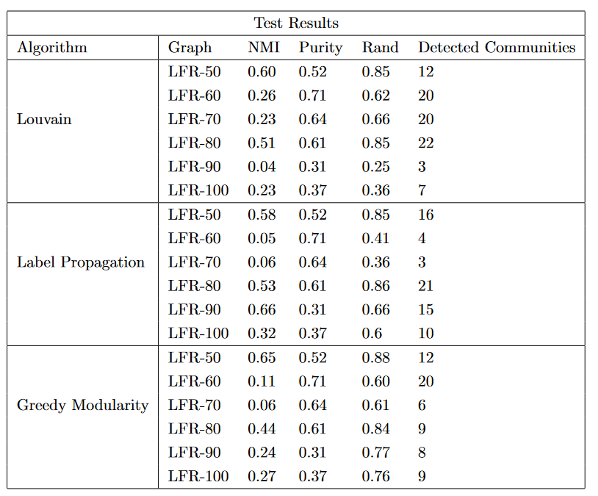
Community Detection – Test Results

Slide 10
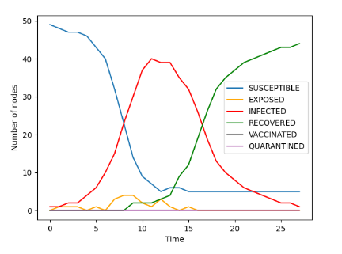
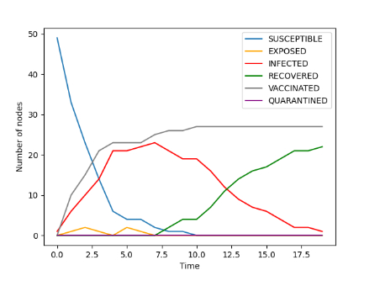
Evaluation – SEIR Model
Painstakingly checking state changes
Monitor changes in infections when preventive measures are implemented

Slide 11
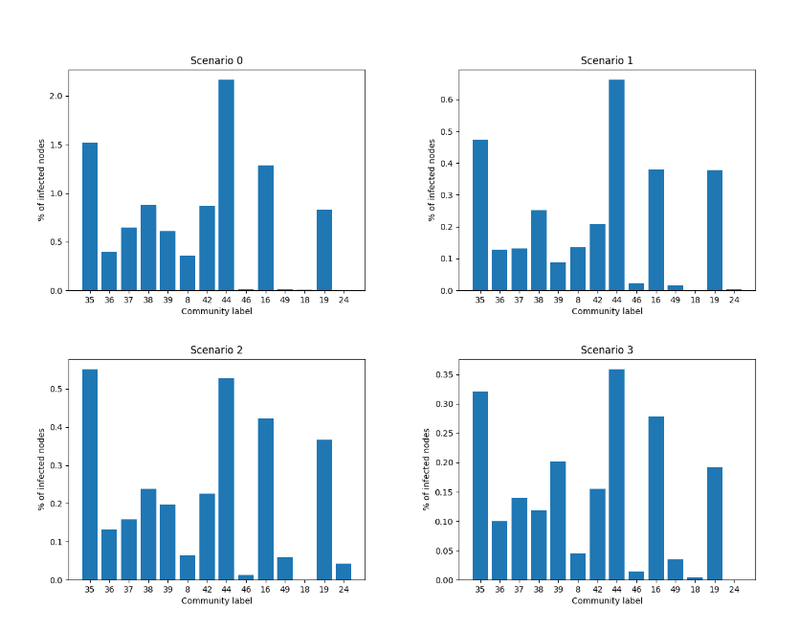
Results
Studying communities reveals how the topology of a network influence the spread of a virus
Some communities are more affected than others
Focusing the efforts on a community might be beneficial

Slide 12
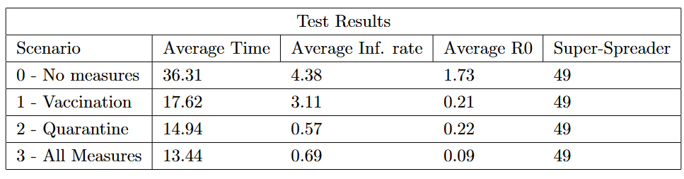
Results
More measures implemented does not mean better results
Some measures have better results than others
The network topology might favour a specific measure

